Slide 1
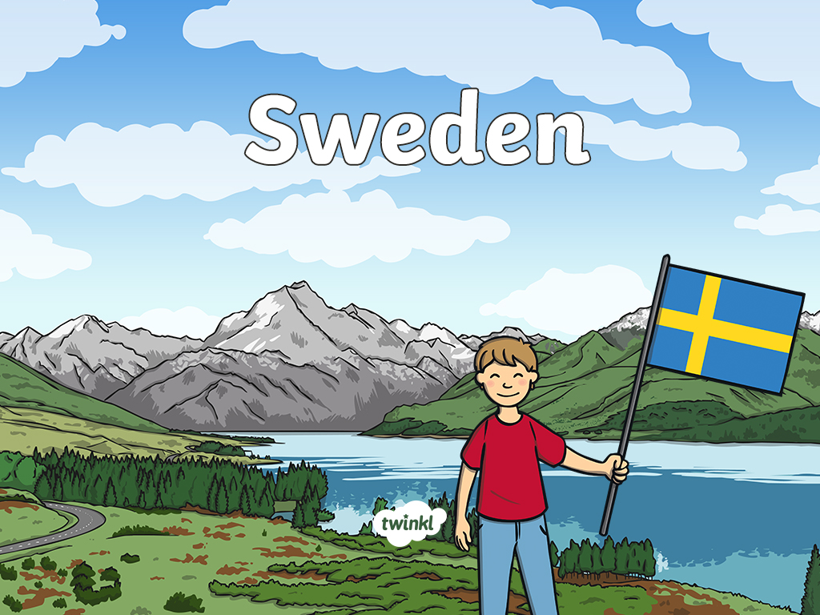

Slide 2
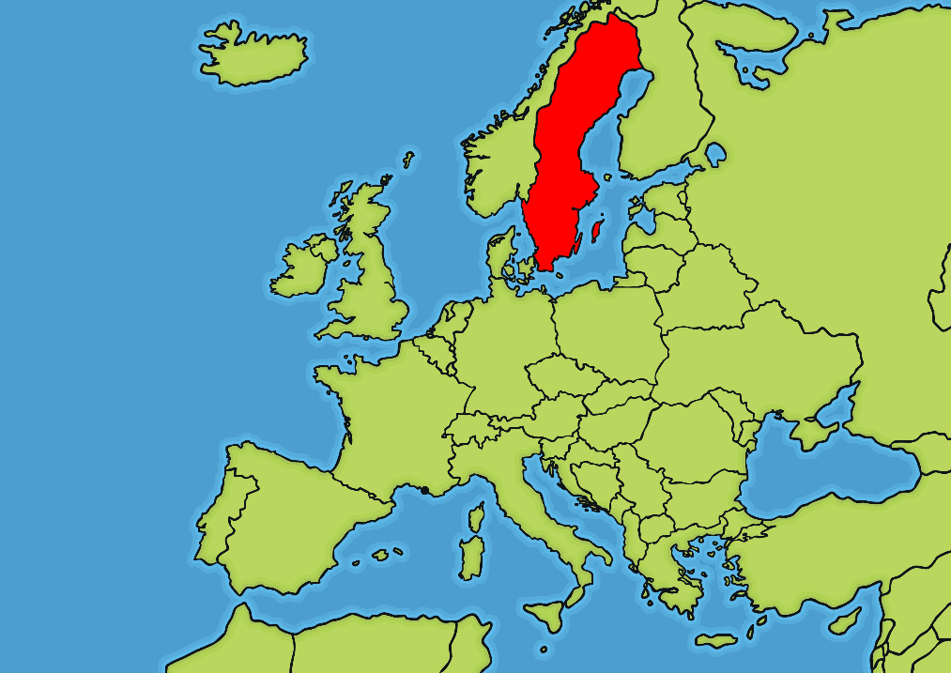
Where Is Sweden?
Sweden is a country in Europe.
Sweden shares borders with Norway and Finland. There is also a bridge connecting Sweden to Denmark.
Sweden

Slide 3
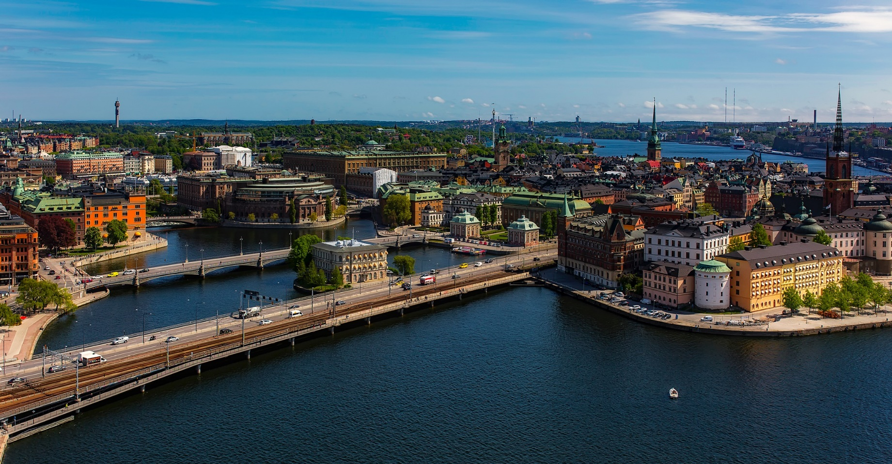
Facts About Sweden
The official name of Sweden is the Kingdom of Sweden. The capital city of Sweden is Stockholm.

Slide 4
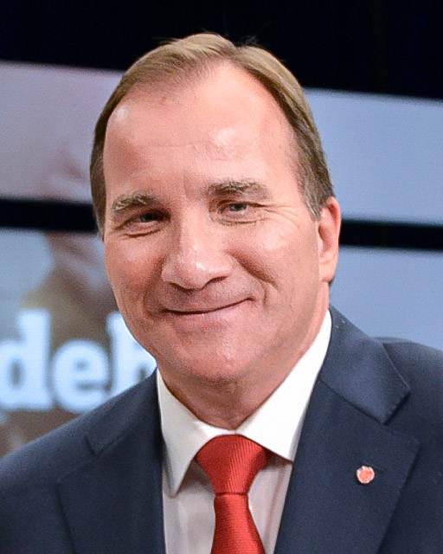
Facts About Sweden
Sweden has a population of almost 10 million.
The prime minister of Sweden is Stefan Löfven.
The currency is the Krona.
Swedish is the official language spoken in Sweden. There are also 5 other languages spoken in Sweden: Finnish, Yiddish, Sami, Meänkieli and Romani.
“Stefan Löfven efter slutdebatten i SVT 2014 den 12 september 2014” by [Frankie Fouganthin] is licensed under CC BY 4.0

Slide 5
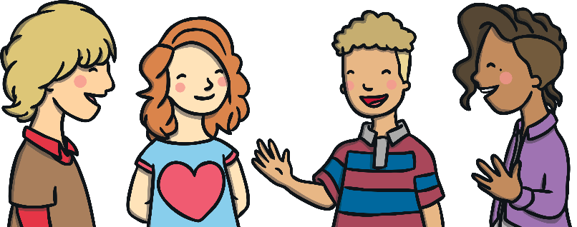
Some Swedish Phrases
Hej
Hello.
Hej då
Goodbye.
Ja
Yes.
Nej
No.
Tack
Thank you.

Slide 6
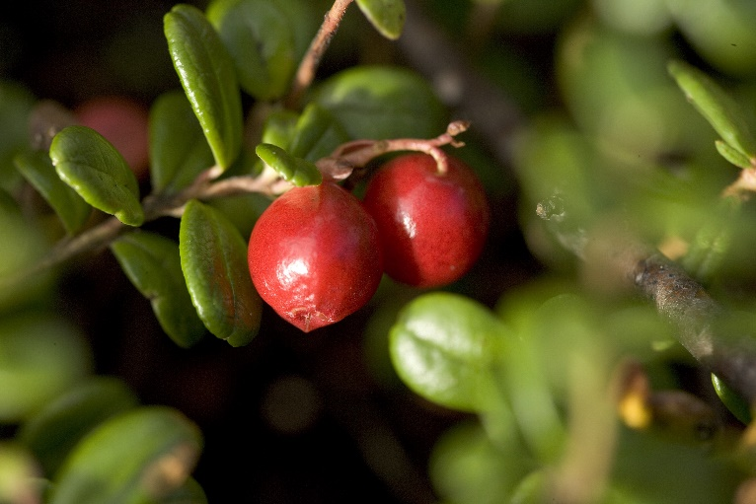
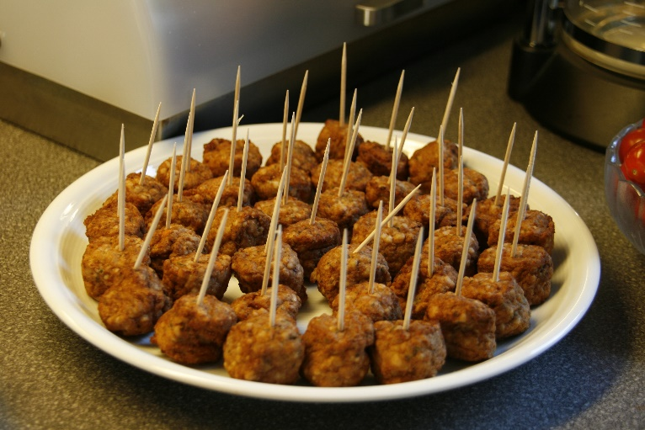
Swedish Food
Lingonberry jam is used on lots of different foods in Sweden.
People can pick lingonberries and make their own jams.
A traditional and famous dish of Sweden is Swedish meatballs served with gravy, boiled potatoes and lingonberry jam.

Slide 7
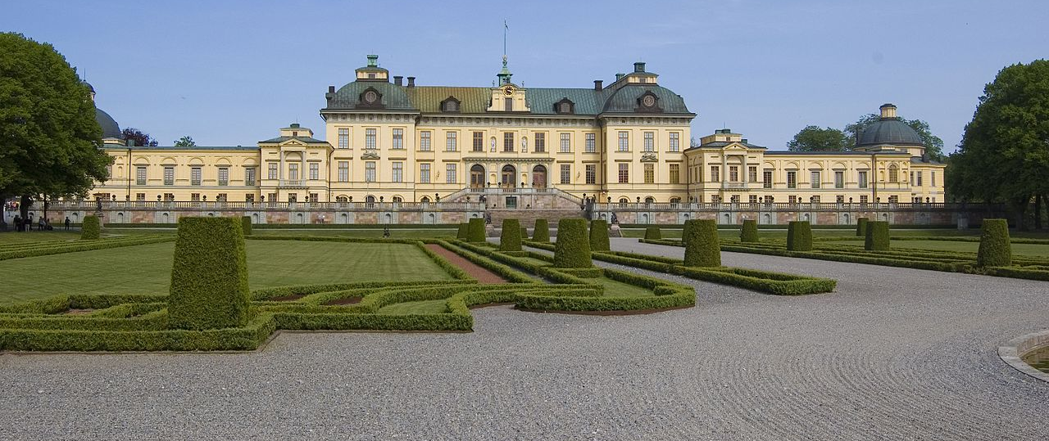
Drottningholm Palace
Drottningholm Palace on the island of Lovön is a UNESCO World Heritage Site. It is close to the city of Stockholm.
It was built during the 17th century and is now the official residence of the Swedish royal family.
“drottningholmpalace” by [Sxenko] is licensed under CC BY 2.5

Slide 8
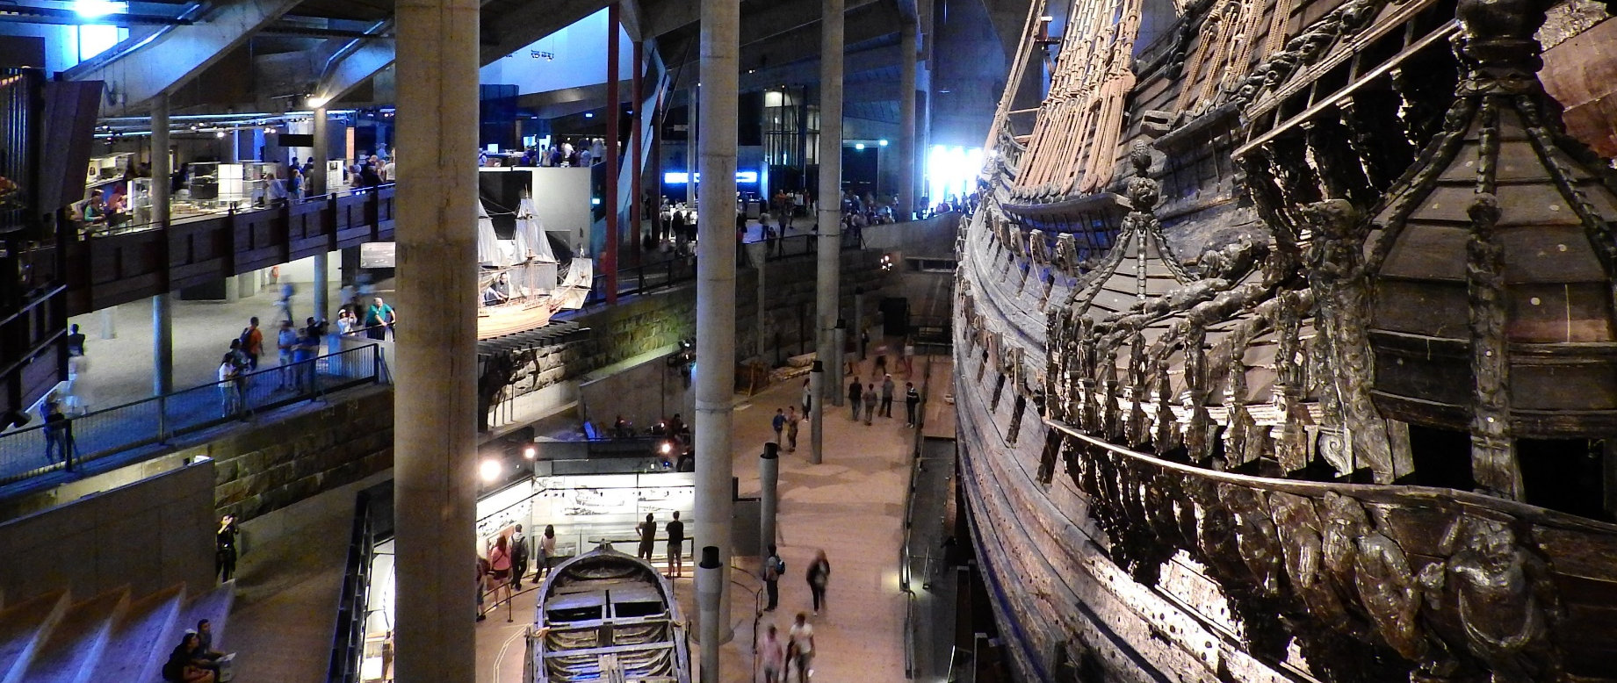
Vasa Museum
The Vasa Museum in Stockholm is one of the country’s most popular tourist attractions.
In 1628, the Vasa battleship sank on its maiden voyage. It was under water for over 300 years until it was recovered in 1961.

Slide 9
